Slide 1


Credit Card Fraud Detection

Slide 2









Team Member
Afnan Alotaibi
Aessha Mater
Atheer Rashed
Rahaf Saeed
Sara Moshabab
Salma Mohammed
Husam Alzain
Marwah Barnawi
Waad Alharthi

Slide 3


CONTENT
01
02
03
04
05
Problem Definition
& Objectives
Data Exploration
Data Cleaning & EDA
Model Building
Model Deployment

Slide 4

Problem Definition
Increasing instances of credit card fraud pose a significant threat to financial institutions and cardholders alike. The existing credit card fraud detection systems often encounter challenges in early identification and accurate differentiation of legitimate transactions from fraudulent activities. Addressing this issue requires innovative approaches, advanced technologies, and a comprehensive understanding of evolving fraud patterns to enhance the efficiency, accuracy, and real-time monitoring capabilities of credit card fraud detection systems.

Slide 5

Objectives
Accuracy
Feature Importance
Imbalanced Dataset Handling
Achieve a high level of accuracy in identifying fraudulent transactions to minimize financial losses and maintain trust in the credit card system.
Identify and understand the most important features contributing to fraud detection, providing transparency and explain ability to stakeholders.
Address the class imbalance issue inherent in fraud detection datasets by employing techniques such as oversampling, undersampling,
.

Slide 6
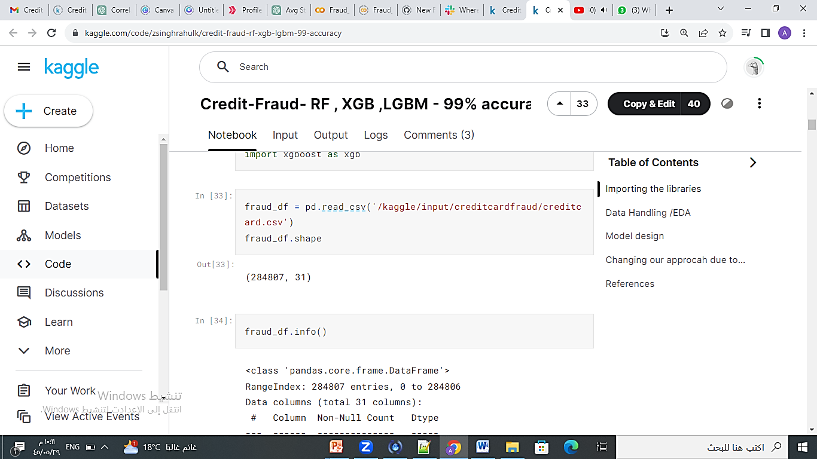
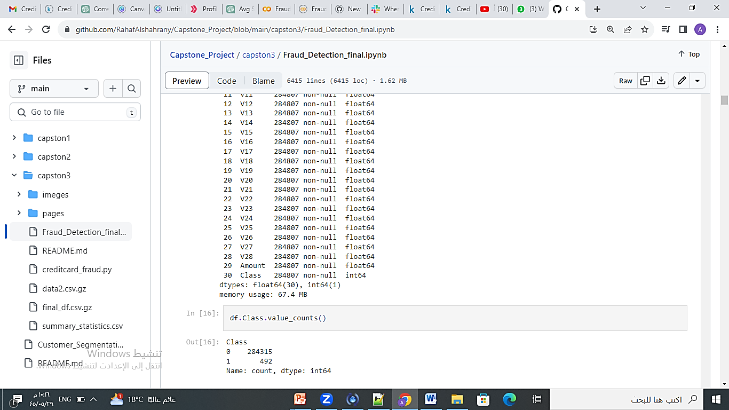
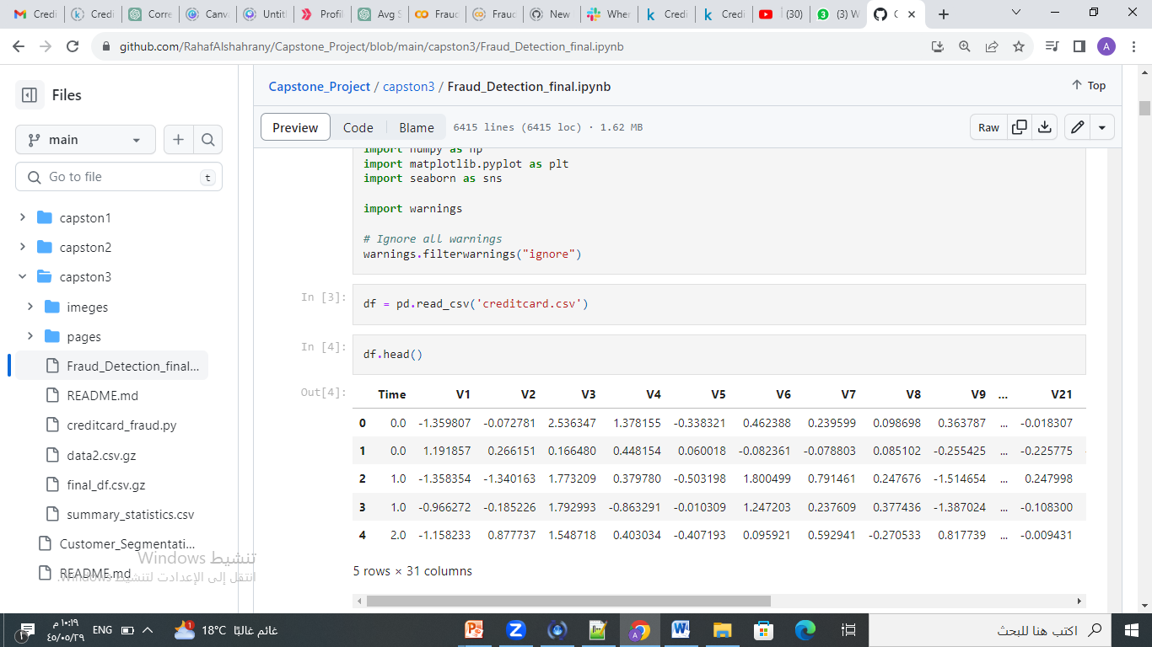

Data Exploration

Slide 7
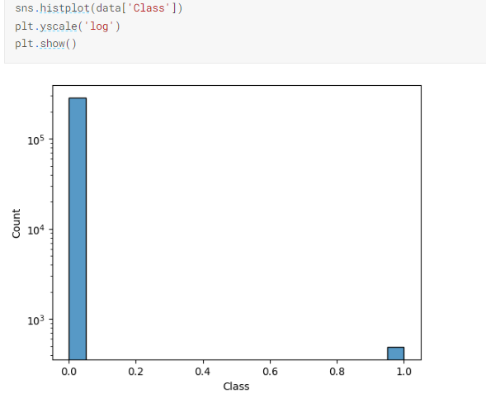
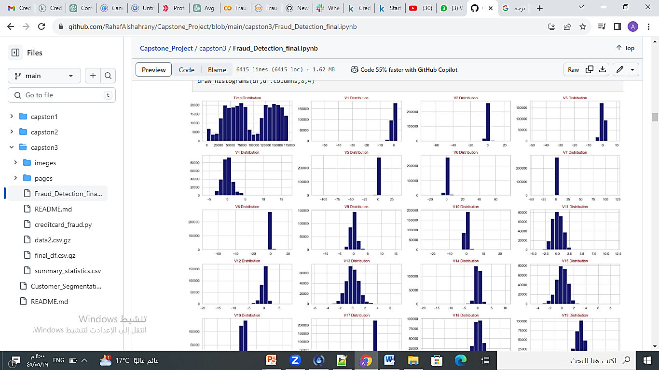
Data Exploration
Class Distribution
Histogram for each feature

Slide 8

Model Building
Logistic Regression
Random Forest
Neural Network
.
XGBoost
Robust Scaler
1000 iterations
Robust Scaler
Max depth 7
Vanilla
4 hidden dense layers with Relu activation
50 epochs
 | Precision | Recall | F1
0 | 1.00 | 1.00 | 1.00
1 | 0.83 | 0.65 | 0.73
 | Precision | Recall | F1
0 | 1.00 | 1.00 | 1.00
1 | 0.95 | 0.78 | 0.85
 | Precision | Recall | F1
0 | 1.00 | 1.00 | 1.00
1 | 0.91 | 0.81 | 0.85
 | Precision | Recall | F1
0 | 1.00 | 1.00 | 1.00
1 | 0.81 | 0.81 | 0.81

Slide 9
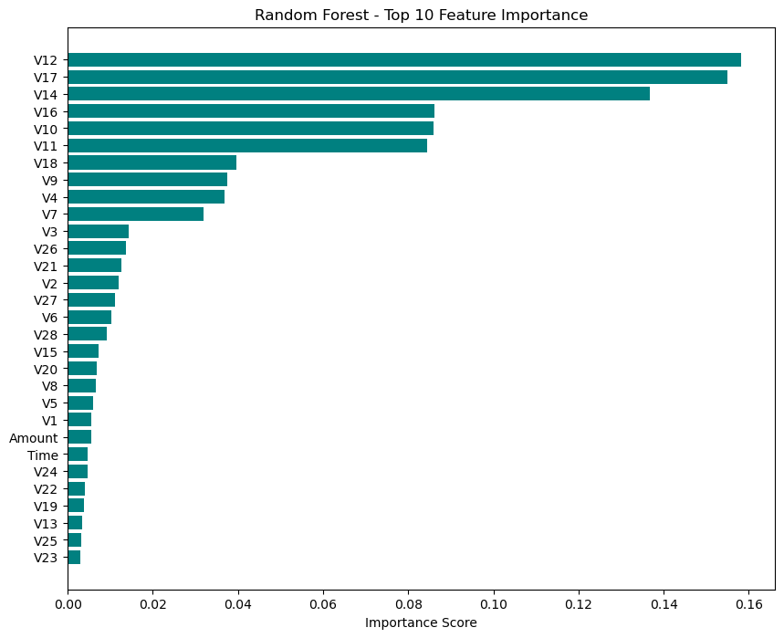
Model Deployment
Random Forest
Trained using top 10 important features
 | Precision | Recall | F1
0 | 1.00 | 1.00 | 1.00
1 | 0.91 | 0.84 | 0.87

Slide 10

Thank you !

